Slide 1

Data Visualization - Global Food Wastage

Slide 2
Table of Contents
Background
Objective
Methodology
Highlight 1
Highlight 2
Conclusion
Reference
Q & A

Slide 3

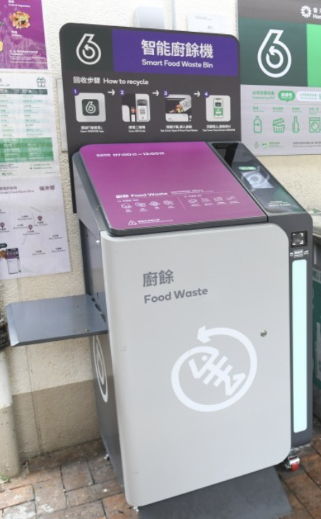
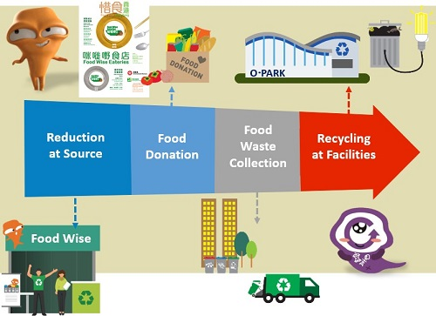
Background - Food waste in Hong Kong
82 Recycling Stores (綠在區區回收環保站) in Hong Kong [1]
smart food waste recycling bins installed in 251 public housing estates [2]
in 2022, 11,130 tonnes of Municipal Solid Waste (MSW) were landfilled daily, 3,300 tonnes (≈30%) were food waste [3]
Food Waste Management Strategy [3]

Slide 4

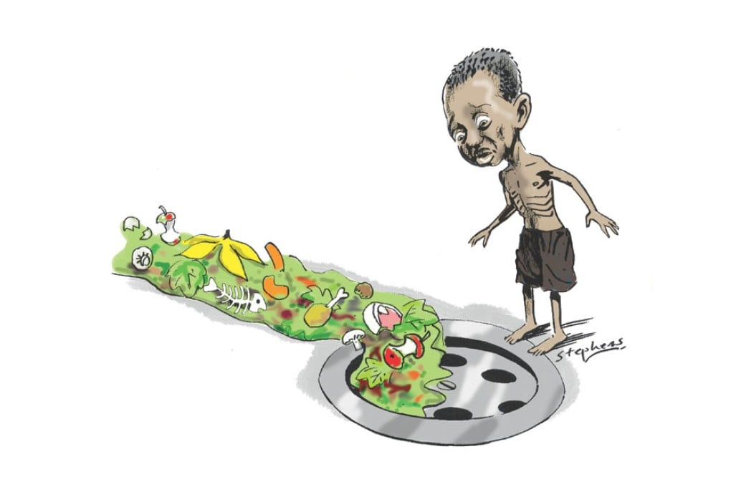

Background – Global Food Waste
over US$1 trillion worth of food is wasted each year (World Bank 2020) [4]
more than one-third of all food produced globally ends up as waste
Food Impact
  Resource Waste
  Food insecurity
  Greenhouse gas emissions (8-10% due to food waste)
  Abundant economic loss

Slide 5
Objective
To examine the severity of global food waste and economic loss from food waste in recent years
Derive data-driven insights to inform future policy priorities.
Hypothesis
Global economic growth and population growth increases food demand, leading to overproduction and rising food waste.
Developed countries face greater economic losses from food waste than developing nations.

Slide 6

Methodology
Kaggle [4]
contains 5,000 records
covering food wastage across 20 countries
spanning 7 years (2018-2024)

Slide 7
Challenges, Limitations & Future Work
Challenges & Limitations
Current scope: Focused on food waste patterns by food categories, waste amounts, and population size
Missing factors: Key country-level variables not captured in dataset
  Future improvement
Include GDP per capita to reflect economic context
Assess food supply chain efficiency
Consider urbanization rates and their impact on consumption/waste
Integrate infrastructure development indicators

Slide 8
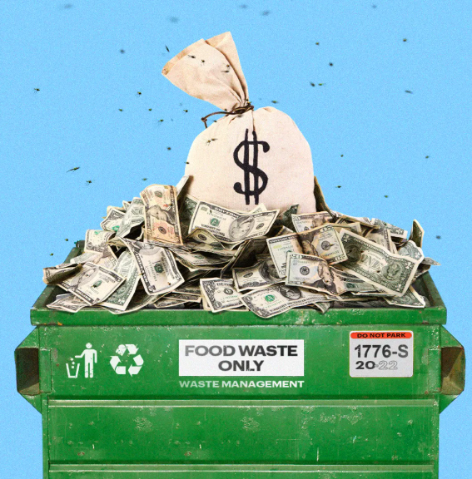
Conclusion
  Key takeaways and Implication
  Overall
Strong Positive Correlation between Food Waste and Economic Loss > Global Challenge
  Food waste isn't just an environmental issue—it carries a significant economic cost globally year after year
Country Level (Developed vs. Developing Countries)
Top Food Waste & Economic Loss Countries: Developing country -- Spain, Turkey ; Developed Country -- Canada
Developing countries show consistently higher food waste and economic losses compared to developed countries
Household food waste tends to be lower in developed countries
  Likely due to stronger awareness, education, and recycling infrastructure
Population: No clear correlation between population size and food waste levels
  High food consumption does not necessarily result in greater waste
Food Category Level
Prepared food is a leading contributor to global food waste & economic loss
  Underscores its role as a mainstream form of consumption worldwide
  a potential focus area for reducing global food waste & economic loss

Slide 9
Reference
https://www.wastereduction.gov.hk/en-hk/waste-reduction-programme/greencommunity
https://www.foodwasterecycling.hk/Smart_Bin_Locations.pdf
https://www.epd.gov.hk/epd/english/environmentinhk/waste/prob_solutions/food_waste_challenge.html
https://wedocs.unep.org/handle/20.500.11822/45230
https://www.kaggle.com/datasets/atharvasoundankar/global-food-wastage-dataset-2018-2024/data
https://www.un.org/en/development/desa/policy/wesp/wesp_current/2014wesp_country_classification.pdf

Slide 10
End

